Slide 1

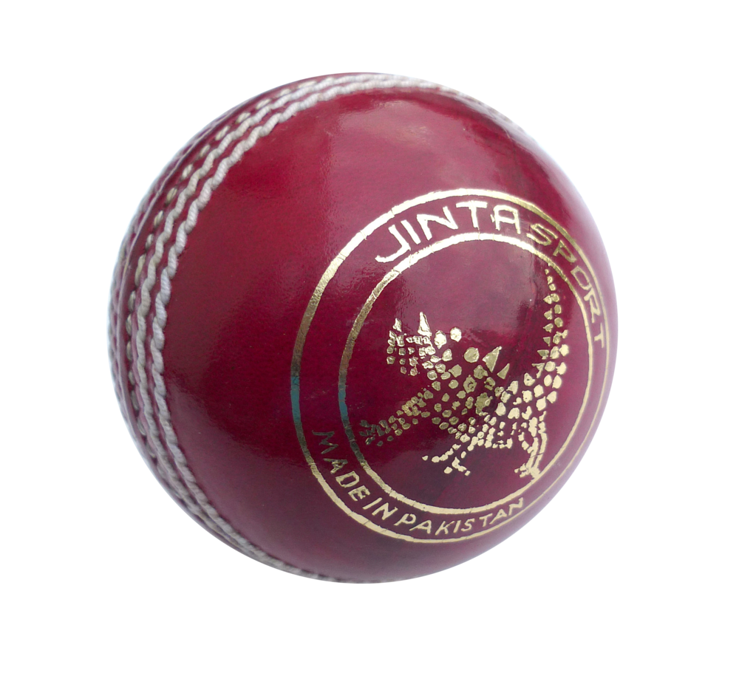
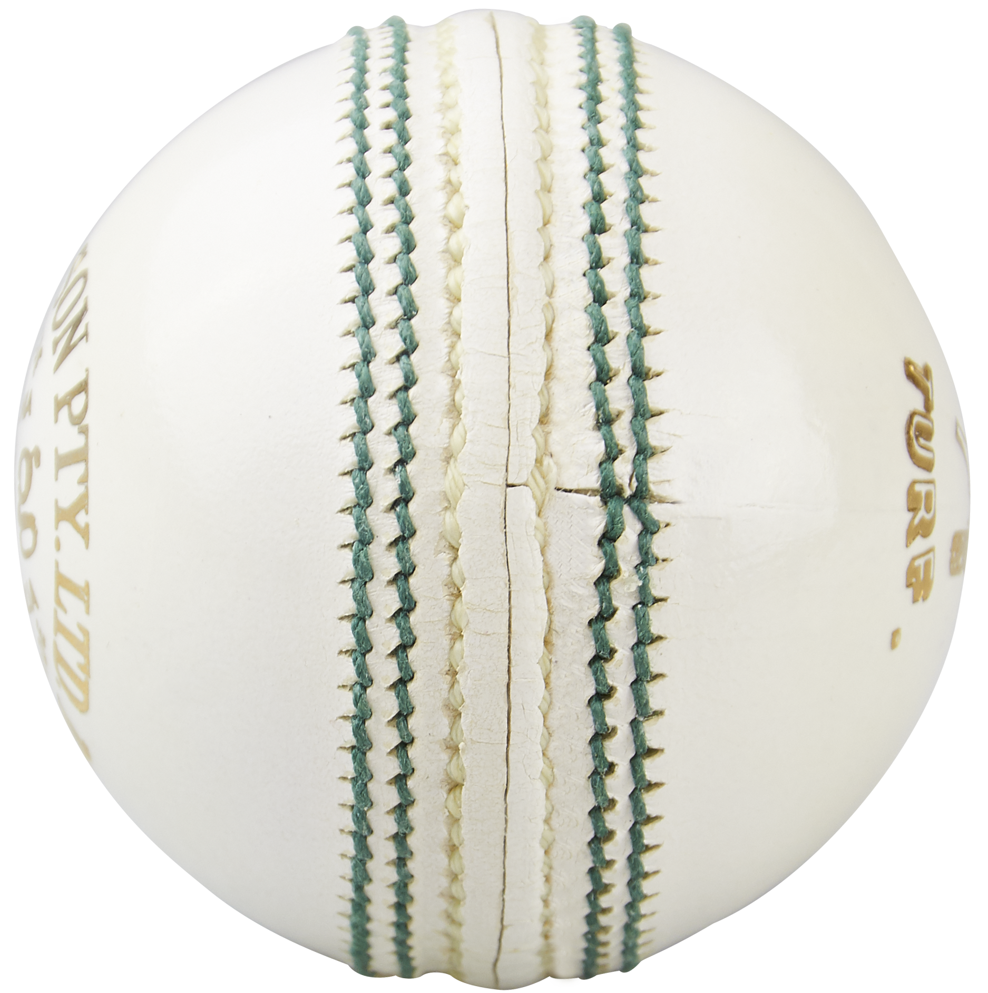
RED BALL TEAM – WHITE BALL TEAM
SUBMITTED BY:
PADMA REVANTH & G VENKATA NARASIMHA

Slide 2
CONTENTS
Introduction
Problem Statement
Web Scraping Details
Libraries Used
Data Cleaning and Data Manipulation
EDA(Exploratory Data Analysis)
Summary
challenges

Slide 3
INRTODUCTION
When we look in to the teams which are playing Test ,ODI & T20 formats we can observe frequently occurring players in each formats.
Most of the players are playing 3-formats of crickets, as we know each format of cricket requires different kinds of skillset.
We are going to form teams with respect to the required format skills.

Slide 4
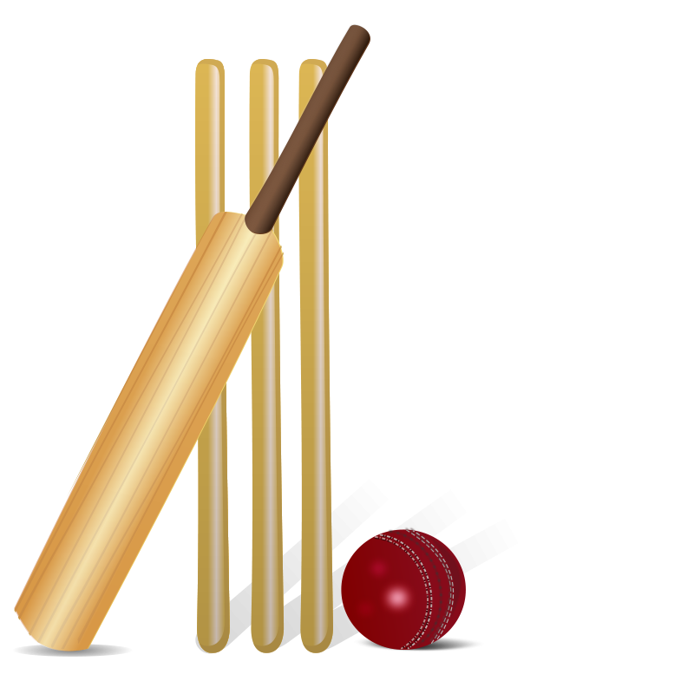
PROBLEM STATEMENT
Based on player skills , we are going to build two equally efficient teams in two formats(Test , ODI) of cricket accordingly.

Slide 5
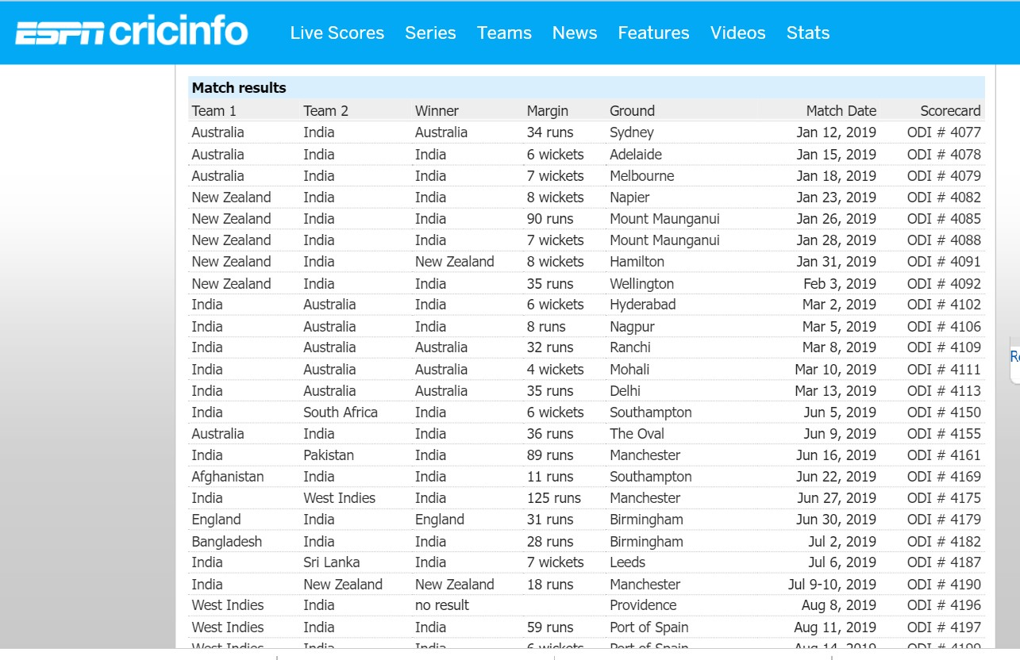
USE CASE DOMAIN (ESPNCRICINFO)
WEBSITE

Slide 6
WEB SCRAPING
Libraries used:
Steps:
Find URL that you want to scrape.
Inspect the Page.
Identify the data you want to extract
Creating DataFrames with extracted data
Requests
Regular Expression(RE)
BeautifulSoup

Slide 7
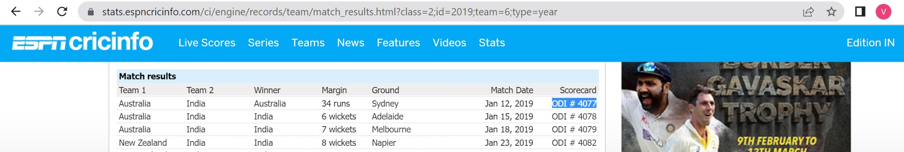
Iterating through 2019-2023 URL

Slide 8
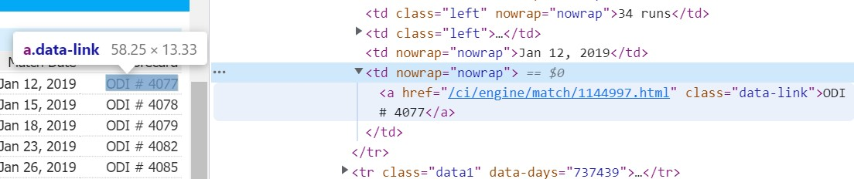
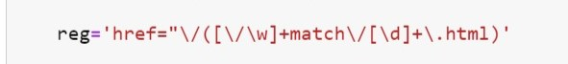
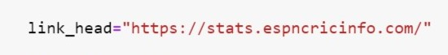
Using Regex to get all links for Scorecards and iterating through all scorecards
+
(link tail)

Slide 9
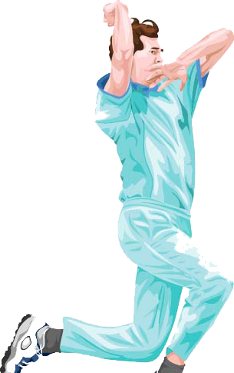
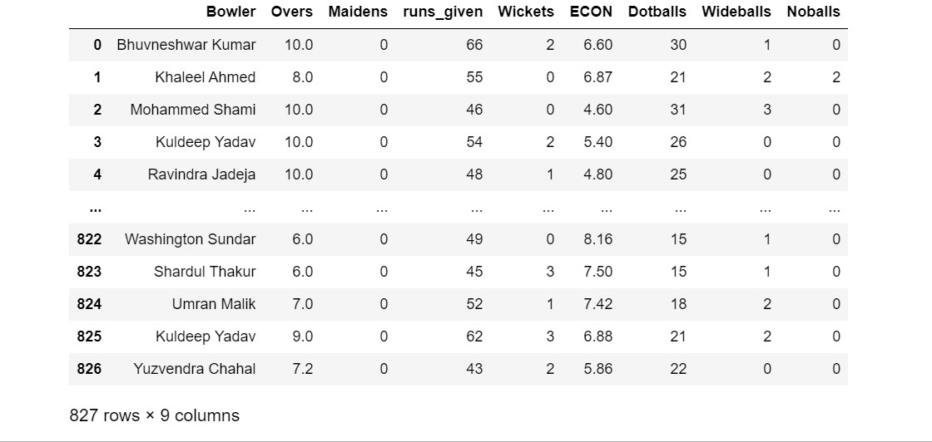
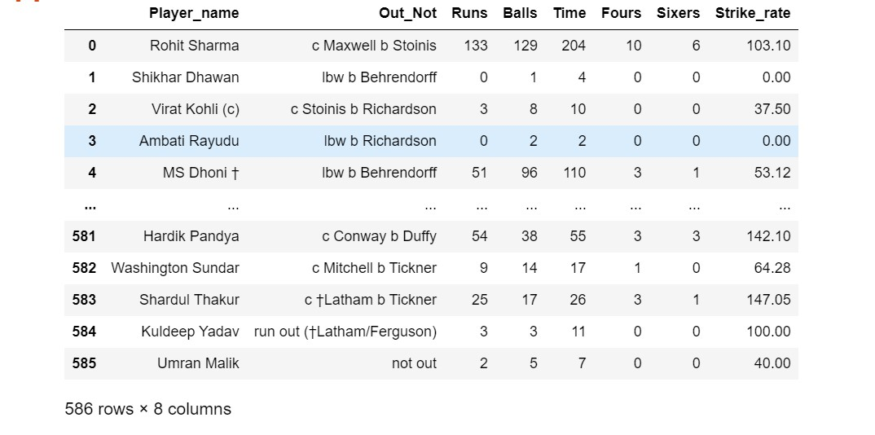
COLLECTED DATAFRAMES
ODI BATTING
ODI BOWLING

Slide 10
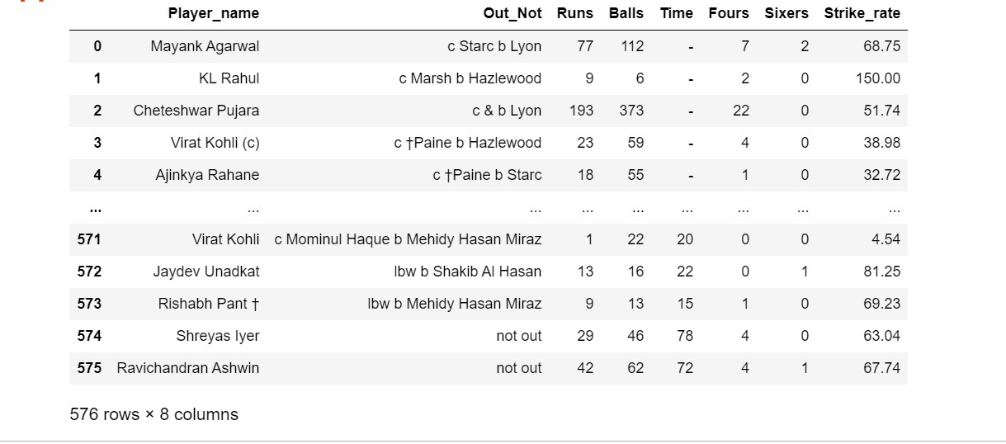
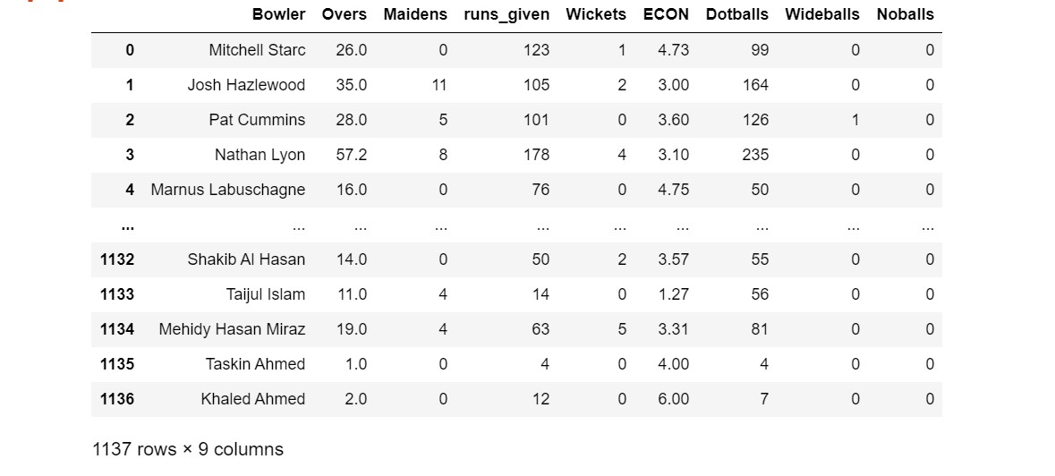
COLLECTED DATAFRAMES
TEST BATTING
TEST BOWLING

Slide 11

DATA CLEANING
Data Cleaning Steps:
Check for Duplicates.
Drop the duplicate column and unnecessary columns.
Checking and removing special characters.
Identifying and imputing missing values.
Data Type conversion.

Slide 12
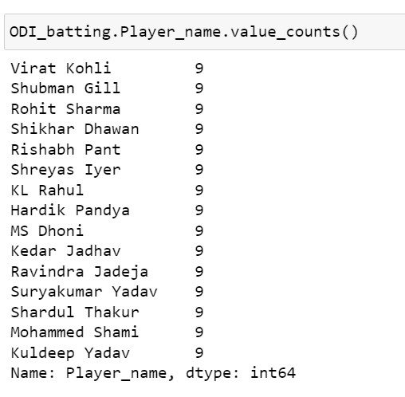
PREPARING DATAFRAMES FOR EDA
After cleaning the data Before Doing EDA (Exploratory Data Analasis) we have the data which is not proper while Comparing two players
To remove bias we took best played 3 matches not well played 3 matches and the middle rows after sorting the “Runs” column

Slide 13
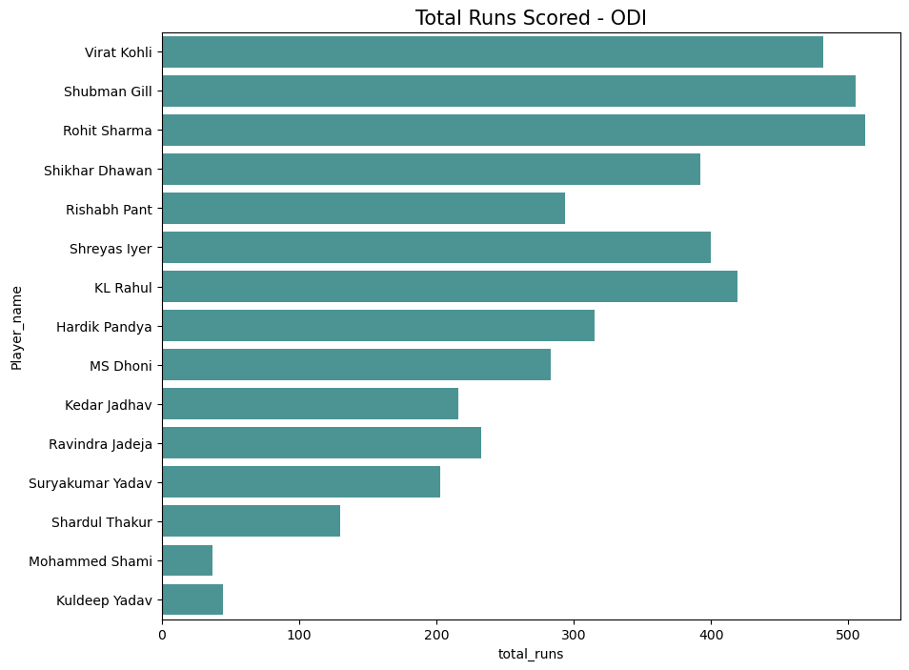
EDA(Exploratory Data Analysis) ODI
Observation:
By observing above plot Rohit Sharma scored most runs and we are going to pick top 9 players so we are roping
Shubman Gill,
Virat Kohli,
KL Rahul,
Shreyas Iyer,
Shikhar Dhawan
Hardik Pandya,
Rishabh Pant,
Ravindra Jadeja
into the pannel based on their average

Slide 14
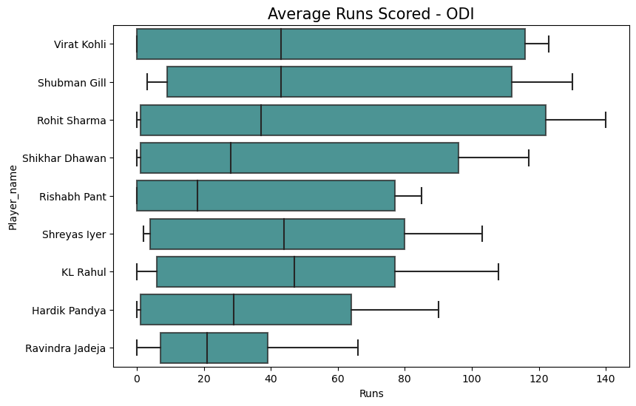
based on runs and consistancy Rohith Sharma and KL Rahul are the openers and Virat Kohli is the 3rd player Shubman Gill is 4th player Now we are going to select middle order

Slide 15
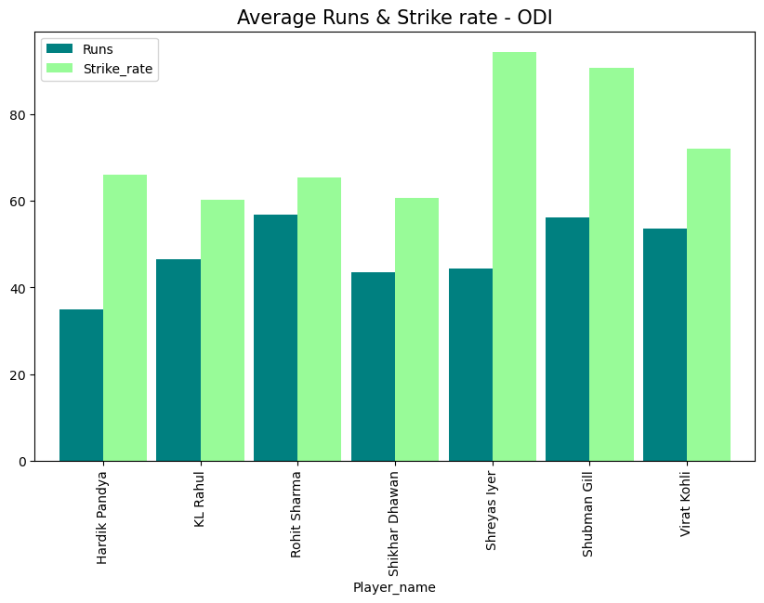
Middle order requires players with good strike rate so we are selecting Shreyas Iyer and
Hardik Pandya as 5th and 6th players respectively

Slide 16
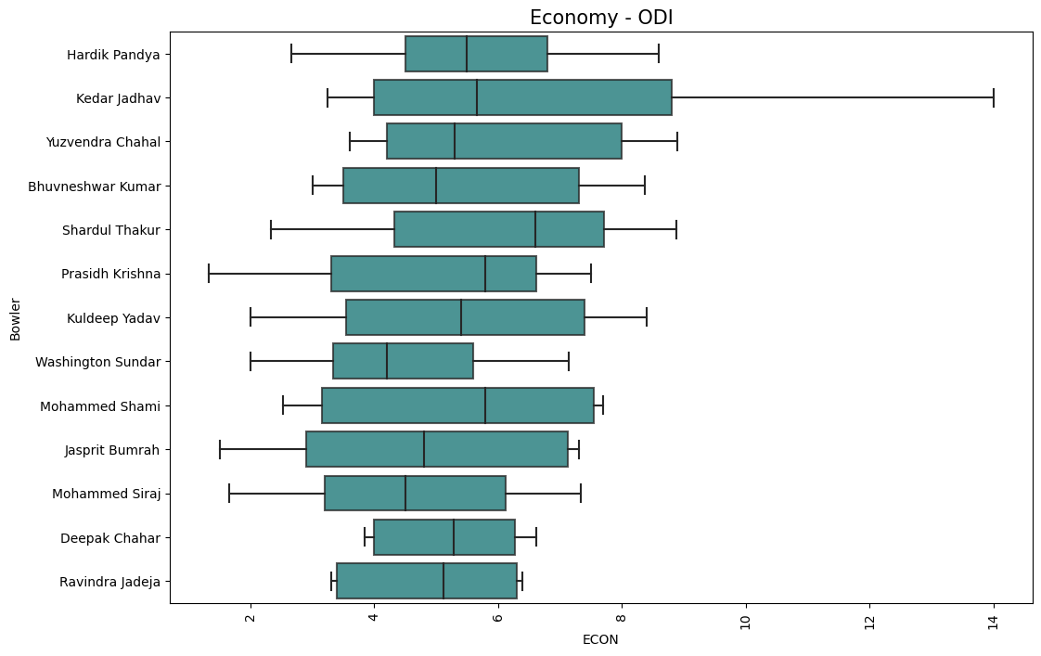
Observation:
By observing above plot Washington Sundar is having minimum Economy and we are going to pick top 9 players so we are roping
Mohammed Siraj
Jasprit Bumrah
Bhuvneshwar Kumar
Yuzvendra Chahal
Kuldeep Yadav
Deepak Chahar
Kedar Jadhav
Mohammed Shami
into the pannel based on their average Econamy

Slide 17
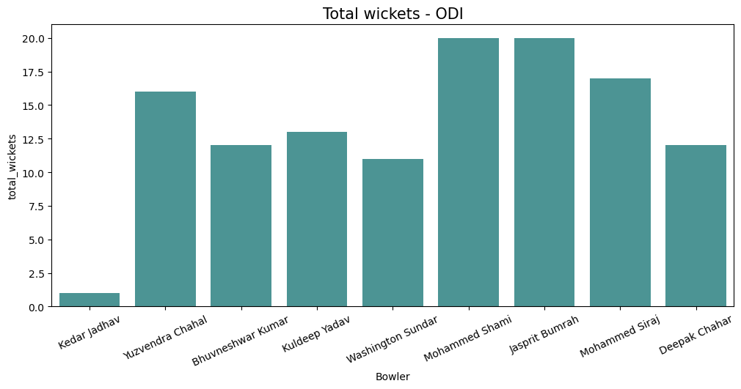
we are selecting Mohammed Shami and Jasprit Bumrah cause they are having more number of wickets though Washington Sunder is not having more wickets in his records he is having least ECONOMY so we are selecting these 3 players

Slide 18
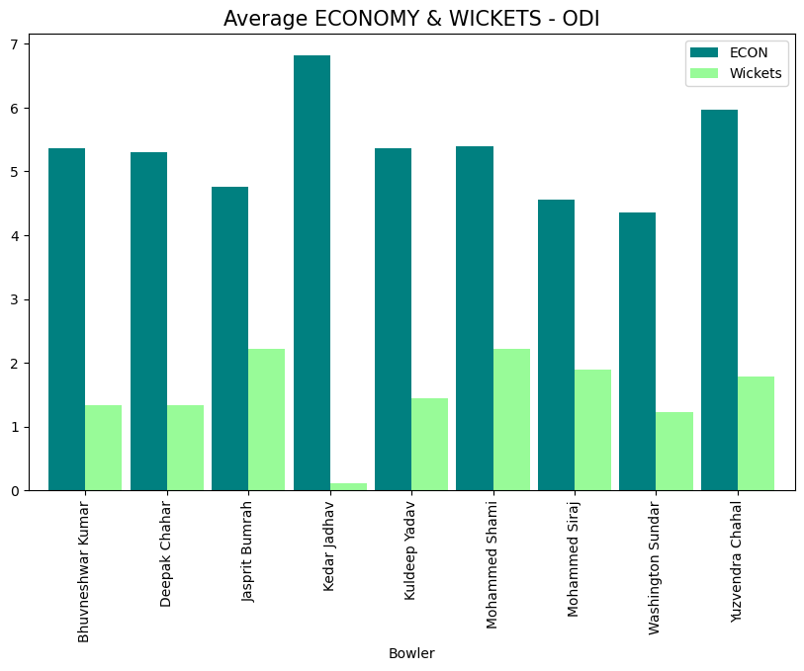
By observing this plot we can pick Mohammed Siraj as we can see he is having good ECON and wickets

Slide 19

ODI PLAYING Ⅺ
Rohith Sharma
KL Rahul
Virat Kohli
Shubman Gill
Shreyas Iyer
Hardik Pandya
Ravindra Jadeja
Washington Sunder
Mohammed Shami
Mohammed Siraj
Jasprit Bumrah

Slide 20
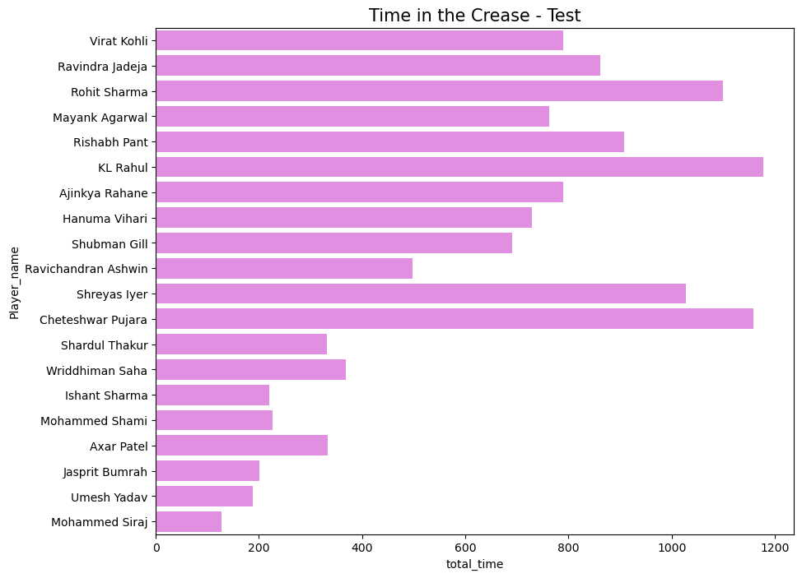
EDA(Exploratory Data Analysis) TEST
Observation:
By observing above plot KL Rahul Stayed most time on the crease and we are going to pick top 10 players so we are roping
Cheteshwar Pujara
Rohit Sharma
Shreyas Iyer
Rishabh Pant
Ravindra Jadeja
Virat Kohli
Ajinkya Rahane
Mayank Agarwal
Hanuma Vihari
into the pannel based on their total time on crease

Slide 21
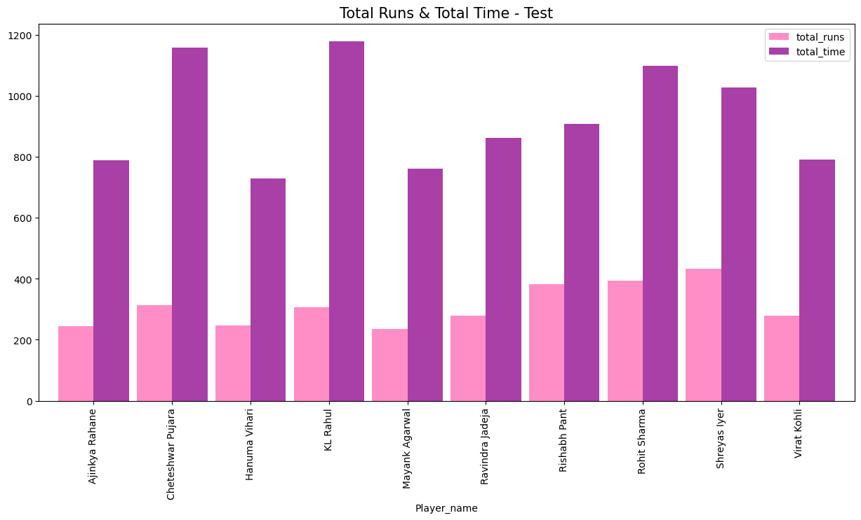
We are selecting Cheteshwar Pujara , KL Rahul , Shreyas Iyer and Rohit Sharma based on their Runs and Crease time

Slide 22
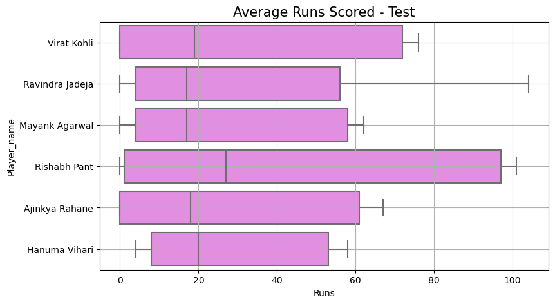
We are selecting Rishabh Pant and Hanuma Vihari based on their Average Runs

Slide 23
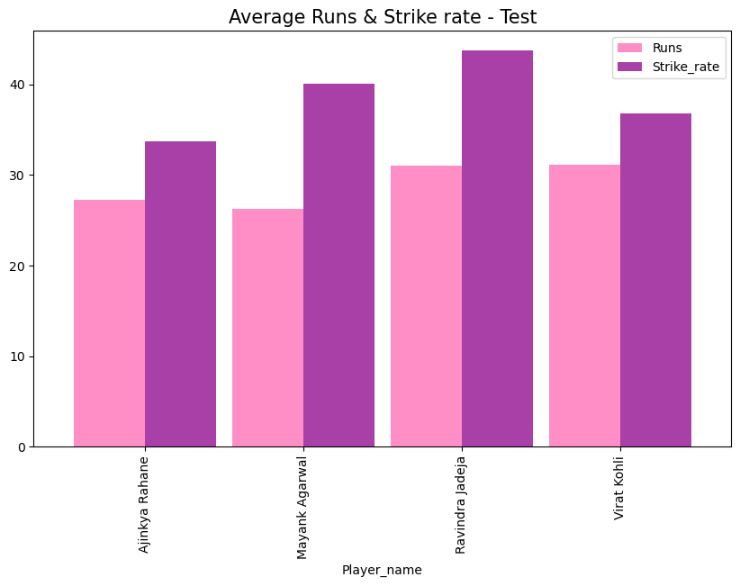
We are selecting Ravindra Jadeja based on his Average Runs & Strike rate

Slide 24
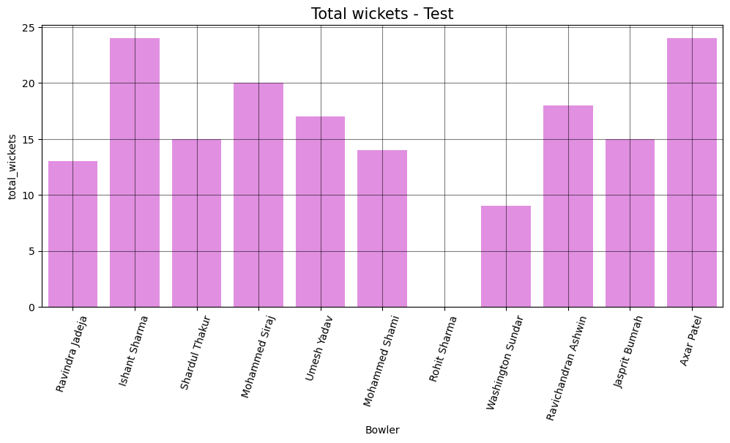
Observation:
By observing above plot Ishant Sharma is having maximum Wickets and we are going to pick top 6 players so we are roping
Axar Patel
Mohammed Siraj
Ravichandran Ashwin
Umesh Yadav
Shardul Thakur
into the pannel based on their total Wickets

Slide 25
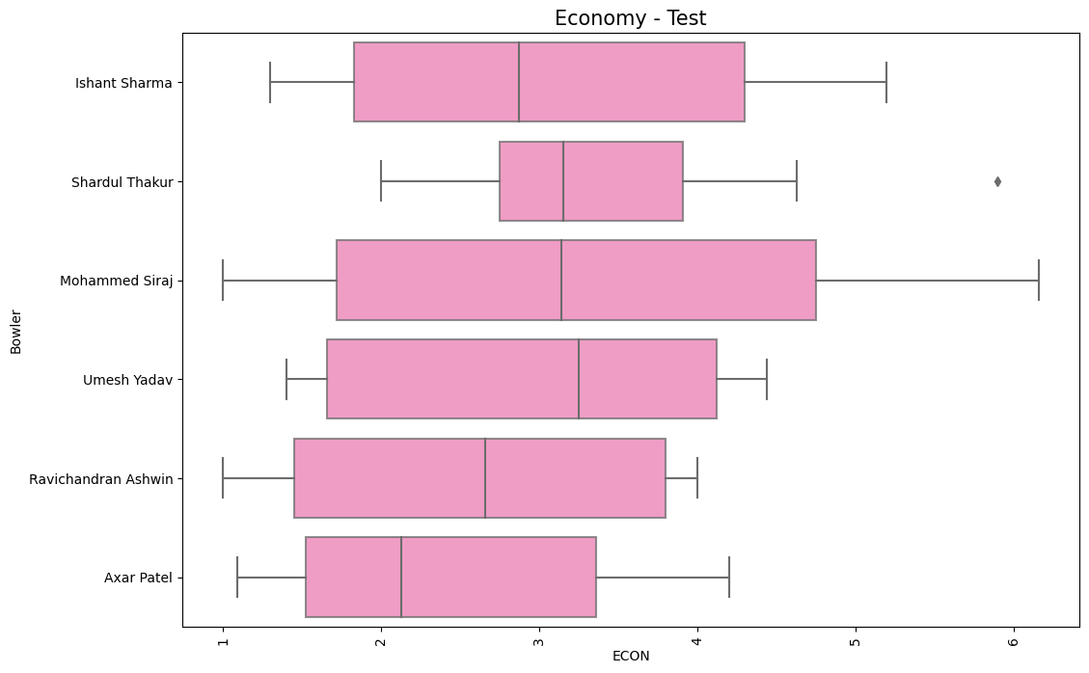
We are selecting Axar Patel , Ravichandran Ashwin and Ishant Sharma based on their Total wickets & ECONOMY

Slide 26
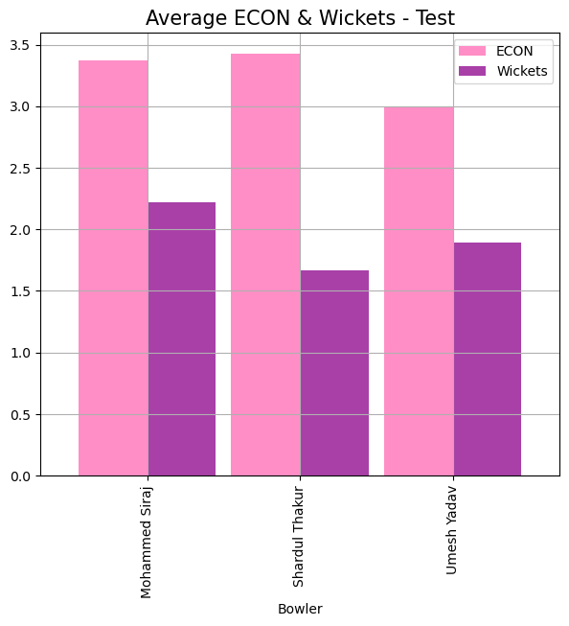
We are selecting Mohammed Siraj considering his Average ECON and Wickets

Slide 27
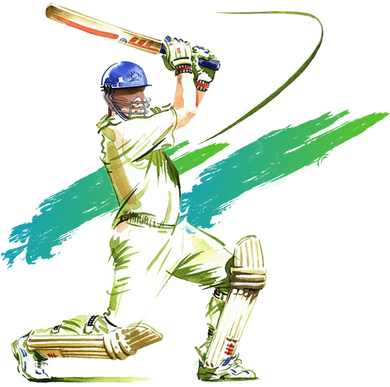
TEST PLAYING Ⅺ
Cheteshwar Pujara
KL Rahul
Shreyas Iyer
Rohit Sharma
Rishabh Pant
Hanuma Vihari
Ravindra Jadeja
Ravichandran Ashwin
Mohammed Siraj
Ishant Sharma
Axar Patel

Slide 28
RED BALL TEAM
WHITE BALL TEAM
Cheteshwar Pujara
KL Rahul
Shreyas Iyer
Rohit Sharma
Rishabh Pant
Hanuma Vihari
Ravindra Jadeja
Ravichandran Ashwin
Mohammed Siraj
Ishant Sharma
Axar Patel
Rohith Sharma
KL Rahul
Virat Kohli
Shubman Gill
Shreyas Iyer
Hardik Pandya
Ravindra Jadeja
Washington Sunder
Mohammed Shami
Mohammed Siraj
Jasprit Bumrah

Slide 29

THANK YOU

